Slide 1
Wireless Communication:
Unit 6

Slide 2
Content
Components of Wireless Communication Systems
Bluetooth: Application, Protocol Stack, Services, Frame Structure, Architecture of Mobile Communication Systems, Wireless Networking Standards, WLAN

Slide 3
Wireless Communication
Wireless communication refers to the transfer of information between two or more devices without the use of physical cables or wires.
It uses electromagnetic waves to transmit data over the airwaves.
Some common examples of wireless communication technologies include:
Wi-Fi: A wireless technology that uses radio waves to provide high-speed internet and network connections.
Bluetooth: A short-range wireless technology that is used for connecting devices such as smartphones, laptops, and headphones.
Cellular networks: A wireless technology that allows for voice and data communication using mobile devices such as smartphones.
Satellite communication: A wireless technology that uses satellites to transmit data over long distances.
RFID (Radio Frequency Identification): A wireless technology that uses radio waves to identify and track objects.

Slide 4
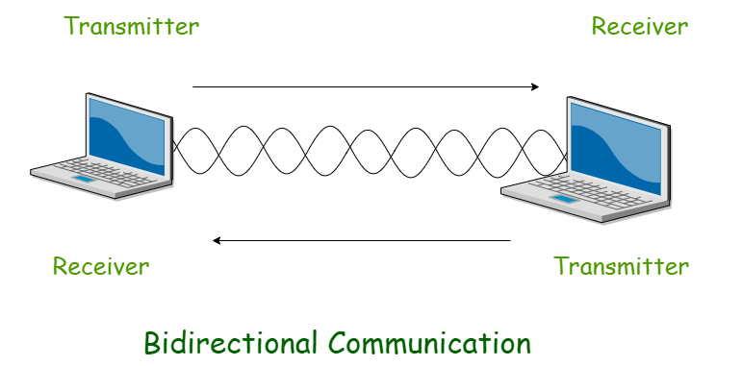
Wireless Communication
Wireless communication has revolutionized the way we communicate and has enabled us to stay connected from virtually anywhere in the world.
It has also led to the development of new technologies and applications, such as the Internet of Things (IoT), which relies heavily on wireless communication to connect devices and sensors.

Slide 5
Components of Wireless Communication Systems
Transmitters:
This component is responsible for encoding the information to be transmitted into a suitable form (such as a modulated radio frequency signal) and transmitting it over the air through an antenna.
A transmitter is an electronic device used in telecommunications to produce radio waves in order to transmit or send data with the aid of an antenna.
The transmitter is able to generate a radio frequency alternating current that is then applied to the antenna, which, in turn, radiates this as radio waves

Slide 6
Components of Wireless Communication Systems
Receiver
The receiver detects the transmitted signal using an antenna and then demodulates the signal to extract the original information.
A receiver is a hardware module or device used to receive signals of different kinds, depending on the context of the application
Antenna
The antenna is responsible for transmitting and receiving radio frequency signals over the air. It converts electrical energy into electromagnetic waves and vice versa.
Antennas can be designed to focus the radiation pattern of the electromagnetic waves, which can improve the signal quality and reduce interference from other sources.
They can also be used to amplify weak signals and filter out unwanted signals.
Antennas with higher gain can increase the range of a wireless communication system, allowing signals to be transmitted and received over longer distances.
Filters
Filters are used to eliminate unwanted signals that may be present in the transmitted or received signals. They are used to eliminate noise and interference, and to ensure that the signal being transmitted or received is of the desired frequency range.

Slide 7
Components of Wireless Communication Systems
Amplifiers
Amplifiers are used to increase the strength of a signal, so that it can be transmitted over a longer distance without losing its strength or quality.
They are also used to increase the sensitivity of a receiver, so that it can detect weaker signals.
Mixers
Mixers are used to convert the frequency of a signal. They are used to combine two signals of different frequencies to produce a new signal with a frequency that is the sum or difference of the two input signals.
This process is known as frequency conversion and is often used in radio communication systems.

Slide 8
Bluetooth
Bluetooth is a network technology that connects mobile devices wirelessly over a short-range to form a personal area network (PAN).
They use short-wavelength, ultra-high frequency (UHF) radio waves within the range 2.400 to 2.485 GHz, for wireless communications.

Slide 9
Bluetooth Usage
Usage of Bluetooth can be broadly categorized into three areas −
Access Points for Data and Voice − Real-time voice and data transmissions are provided by Bluetooth by connecting portable and stationary network devices wirelessly.
Cable replacement − Bluetooth replaces the need for a large number of wires and cables of wired networks. The connections can be made instantly and are retained even when the devices are not within range. The range of the devices is typically 10m. However, the range can be extended by using amplifiers.
Ad hoc networking − Ad hoc networks are formed impromptu by the network devices bypassing the need for a central access point like a router. Bluetooth networks are ad hoc in nature since a Bluetooth enabled device can form an instant connection with another Bluetooth enabled device as soon as it comes into range.

Slide 10
Bluetooth Applications
Some of the common applications of Bluetooth are −
laptops, notebooks and wireless PCs
mobile phones and PDAs (personal digital assistant).
printers.
wireless headsets.
wireless PANs (personal area networks) and even LANs (local area networks)
transfer data files, videos, and images and MP3 or MP4.
wireless peripheral devices like mouse and keyboards.

Slide 11
Protocols in the Bluetooth Protocol Stack
Core protocols − This includes Bluetooth radio, Baseband, Link Manager Protocol (LMP), Logical Link Control and Adaptation Protocol (L2CAP), and Service Discovery Protocol (SDP).
Cable Replacement Protocol − This includes Radio Frequency Communications (RFComm) protocol. It is a Frontend Component. It provides a serial interface with WAP.
Adopted Protocols − These are the protocols that are adopted from standard models. The commonly adopted protocols used in Bluetooth are Point-to-Point Protocol (PPP), Internet Protocol (IP), User Datagram Protocol (UDP), Transmission Control Protocol (TCP), and Wireless Application Protocol (WAP).
AT Commands − Attention command set.
Audio - Handles voice and sound transmission

Slide 12
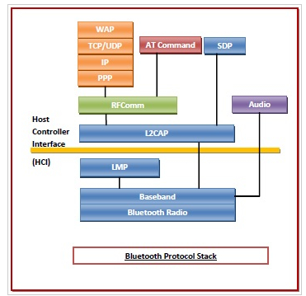
Bluetooth Protocol Stack

Slide 13
Functions of the Core Protocols
Radio − This is a physical layer equivalent protocol that lays down the physical structure and specifications for transmission of radio waves. It defines air interface, frequency bands, frequency hopping specifications and modulation techniques.
Baseband − This protocol takes the services of radio protocol. It defines the addressing scheme, packet frame format, timing, and power control algorithms.
Link Manager Protocol (LMP) − LMP establishes logical links between Bluetooth devices and maintains the links for enabling communications. The other main functions of LMP are device authentication, message encryption, and negotiation of packet sizes.

Slide 14
Functions of the Core Protocols
Logical Link Control and Adaptation Protocol (L2CAP) − L2CAP provides adaption between upper layer frame and baseband layer frame format. L2CAP provides support for both connection-oriented as well as connectionless services.
Service Discovery Protocol (SDP)− SDP takes care of service-related queries like device information so as to establish a connection between contending Bluetooth devices.

Slide 15
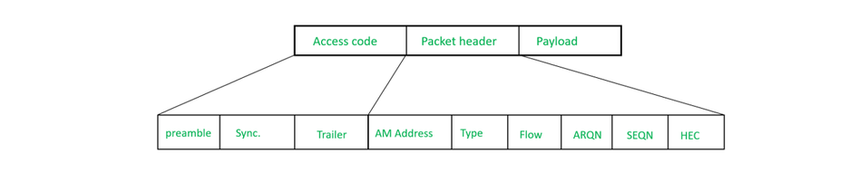
Bluetooth Frame Structure

Slide 16
Bluetooth Frame Structure
Access Code:
It is the first field of Frame Structure.
It is of size 72 bits.
It is again divided into three parts first part is the preamble which is of size 4 bits, the second part is synchronization which is of 64 bits and the third part is a trailer which is of size 4 bits.
Access Code field is used for timing synchronization and piconet identification.

Slide 17
Bluetooth Frame Structure
Packet header:
Its size is 54 bits.
It contains six subfields the first field or part is an address which is of 3 bits in size and can define up to 7 slaves.
The second field is the type which is of 4 bits in size and used to identify the type of data.
The third subfield is flow used for flow control, the fourth field is ARQN used for acknowledgement.
The fifth part is SEQN which contains sequence numbers of frames and the sixth field is HEC used to detect errors in the header.
Payload: This field can be 0-2744 bits long and its structure depends on the type of link established.

Slide 18
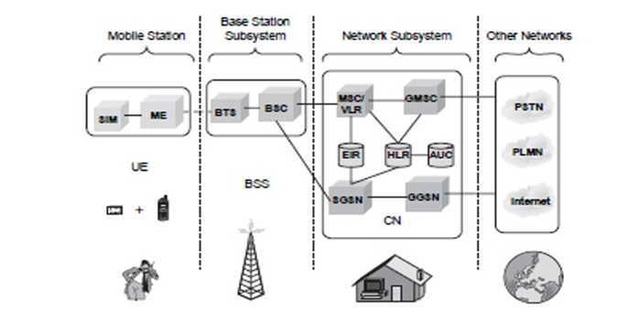
Mobile Communications Architecture
Acronym | Full Form
SGSN | Serving GPRS Support Node
GGSN | Gateway GPRS Support Node
HLR | Home Location Register
VLR | Visitor Location Register
MSC | Mobile Switching Center
BSC | Base Station Controller
GMSC | Gateway MSC
EIR | Equipment Identity Register
ME | Mobile Equipment
SIM | Subscriber Identity Card
PLMN | Public Land Mobile Network
UE | User Equipment
AUC | Authentication center
PSTN | Public Switched Telephone Network

Slide 19
UE
User Equipment (UE)—These are the users .Number of users are controlled by one BTS The mobile stations (MS) communicate with the base station subsystem over the radio the radio interface. The BSS called as radio the subsystem, provides and manages the radio transmission path between the mobile stations and the Mobile Switching Centre(MSC).It also manages radio interface between the mobile stations and other subsystems of GSM. Each BSS comprises many Base Station Controllers(BSC) that connect the mobile station to the network and switching subsystem (NSS) through the mobile switching center.

Slide 20
UE
The NSS controls the switching functions of the GSM system. It allows the mobile switching center to communicate with networks like PSTN, ISDN, CSPDN, PSPDN and other data networks. The operation support system (OSS) allows the operation and maintenance of the GSM system. It allows the system engineers to diagnose, troubleshoot and observe the parameters of the GSM systems.

Slide 21
BSS
Base station(BSS)-- The following stations subsystem comprises of two parts: 1. Base Transceiver Station (BTS). 2. Base Station Controller(BSC). The BSS consists many BSC that connect to a single MSC. Each BSC controls upto several hundred BTS.

Slide 22
Base Transreciver Station(BTS)-BTS It has radio transreciever that define a cell and are capable of handelling radio link protocols with MS. Functions of BTS are 1. Handling radio link protocols 2. Providing FD communication to MS.

Slide 23
Base Station Controller
Base station controller(BSC) IT manages radio resources for one or more BTS.It controls several hundred BTS al are connected to single MSC. Functions of BTS are • To control BTS. • Radio resource management • Handoff management and control • Radio channel setup and frequency hoping

Slide 24
Network Subsystem
Network subsystem( NSS) 1.It handles the switching of GSM calls between external networks and indoor BSC 2.It includes three different data bases for mobility management as A .HLR (Home Location Register) B .VLR (Visitor Location Register) C. AUC (Authentication center)

Slide 25
Mobile switching center (MSC)--
Mobile switching center (MSC)-- It connects fix networks like ISDN ,PSTN etc. Following are the functions of MSC 1. Call setup, supervision and relies 2. Collection of Billing Information 3. Call handling / routing 4. Management of signalling protocol 5. Record of VLR and HLR

Slide 26
HLR (Home Location Register) - Call roamiming and call routing capabilities of GSM are handeled.It stores all the adminstartive information of sub scriber registered in the networks.IT maintance unique international mobile subscriber identity.(IMSI).
VLR (Visitor Location Register) - It is a temporary data base.It stores the IMSC number and costomer information for each roaming customer visiting specific MSC.
Authentication center - It is protected database .It maintance authentication keys and algorithms.It contain s aregister called as Equipment Identity Register.
Operation subsystem(OSS) - IT manages all mobile equipment in the system 1)management for charging and billing procedure 2)To maintain all hardware and network operations

Slide 27
Wireless Standards IEEE
802.11 and 802.11x refers to a family of specifications developed by the IEEE for wireless LAN (WLAN) technology.
802.11 specifies an over-the-air interface between a wireless client and a base station or between two wireless clients. The IEEE accepted the specification in 1997.

Slide 28
Standard | Year | Frequency Band | Max Speed | Key Features | Also Known As
802.11 (original) | 1997 | 2.4 GHz | 1-2 Mbps | First wireless LAN standard using FHSS or DSSS | -
802.11a | 1999 | 5 GHz | 54 Mbps | Uses OFDM encoding scheme | -
802.11b | 1999 | 2.4 GHz | 11 Mbps | Uses DSSS, widely adopted first-generation Wi-Fi | Wi-Fi (original)
802.11g | 2003 | 2.4 GHz | 54 Mbps | Combines features of 802.11a/b, backward compatible | -
802.11e | 2005 | 2.4 GHz and 5 GHz | Depends on underlying standard (up to 54 Mbps) | Quality of Service (QoS) enhancements for better support of voice, video and multimedia applications | WMM (Wi-Fi Multimedia)
802.11n | 2009 | 2.4 GHz and 5 GHz | 600 Mbps | Introduced MIMO technology for improved throughput and range | -
802.11ac | 2013 | 5 GHz only | 3.5 Gbps | Enhanced 802.11n with wider channels and better performance | Wi-Fi 5
802.11ac Wave 2 | #2016 | 5 GHz only | 6.93 Gbps | Added MU-MIMO technology and other enhancements | -
802.11ad | 2012 | 60 GHz | 7 Gbps | Very high speed but limited range | WiGig
802.11ah | 2017 | Below 900 MHz | Lower | Extended range, better wall penetration | Wi-Fi HaLow
802.11r | - | - | - | Fast BSS transition for VoIP handoff between access points | Fast Roaming
802.1X | - | - | - | Not part of 802.11 family; security standard for network access control | -

Slide 29
IEEE Wireless Standards
1. 802.11 (Basic Version):
Allows wireless networks to send data at 1-2 Mbps (megabits per second)
Works in the 2.4 GHz frequency band
Think of this as the "original" wireless communication standard
2. 802.11a:
Faster version that can send data up to 54 Mbps
Works in the 5 GHz band
Allows more data to be transmitted quickly
3. 802.11b:
Also known as "High Rate Wi-Fi"
Improved the original standard
Works between 2.4 and 11 Mbps
Made wireless networks more practical for everyday use
4. 802.11g:
Provides better speed and compatibility
Supports wireless draft standards
Ensures different wireless devices can work together

Slide 30
IEEE Wireless Standards
5. 802.11n:
Supports multiple antennas
Improves network speed and range
Works for both short and long-distance wireless communication
6. 802.11n Standard:
An improvement over previous wireless standards
Introduces multiple antennas (MIMO - Multiple Input Multiple Output)
This means: More data can be sent at the same time, faster and more reliable wireless connections
Up to 4.5 times faster than the previous 802.11g standard
7. 802.11ac Wave 2:
An upgrade to the original 802.11ac standard
Uses advanced techniques like: Multi-user MIMO technology
Allows multiple devices to communicate simultaneously
Helps reduce network congestion
8. 802.11ad:
A cutting-edge wireless specification operates at a very high frequency (60 GHz)
Promises much faster data transfer rates
Theoretical maximum speed up to 7 Gbps (incredibly fast!)

Slide 31
IEEE Wireless Standards
9. 802.11ah (Wi-Fi HaLow):
A special type of Wi-Fi that works in very low-frequency bands (900 MHz)
Has an amazing ability to go through walls and barriers
Can cover almost twice the distance of previous Wi-Fi standards
Great for devices that need long-range communication with low power
10. 802.11r (Fast Basic Service Set):
Helps devices switch between Wi-Fi networks more smoothly
Like a fast lane for changing Wi-Fi connections
Supports "Voice over Wi-Fi" (VoWi-Fi)
Useful for maintaining calls or connections while moving between networks
11. 802.1X:
A security standard for wireless networks
Helps control who can access the network
Works like a security guard checking IDs at a door
Ensures only authorized devices can connect to the network

Slide 32
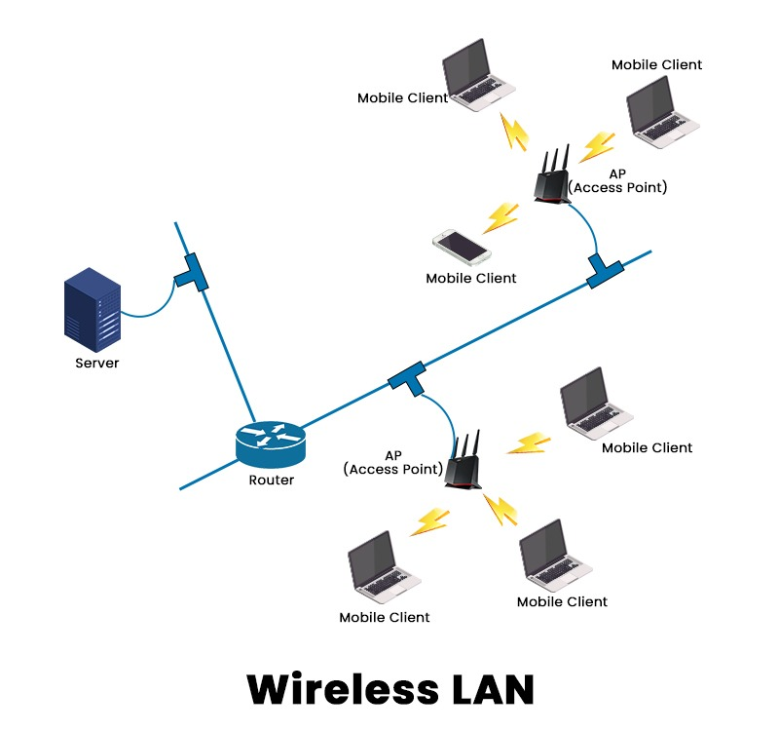
Wireless LAN
Wireless LAN stands for Wireless Local Area Network. It is also called LAWN (Local Area Wireless Network). WLAN is one in which a mobile user can connect to a Local Area Network (LAN) through a wireless connection.
The IEEE 802.11 group of standards defines the technologies for wireless LANs. For path sharing, 802.11 standard uses the Ethernet protocol and CSMA/CA (carrier sense multiple access with collision avoidance). It also uses an encryption method i.e. wired equivalent privacy algorithm.
Wireless LANs provide high speed data communication in small areas such as building or an office. WLANs allow users to move around in a confined area while they are still connected to the network.
In some instance wireless LAN technology is used to save costs and avoid laying cable, while in other cases, it is the only option for providing high-speed internet access to the public.

Slide 33
Advantages of WLANs
Flexibility: Within radio coverage, nodes can communicate without further restriction. Radio waves can penetrate walls, senders and receivers can be placed anywhere (also non-visible, e.g., within devices, in walls etc.).
Planning: Only wireless ad-hoc networks allow for communication without previous planning, any wired network needs wiring plans.
Design: Wireless networks allow for the design of independent, small devices which can for example be put into a pocket. Cables not only restrict users but also designers of small notepads, PDAs, etc.
Robustness: Wireless networks can handle disasters, e.g., earthquakes, flood etc. whereas, networks requiring a wired infrastructure will usually break down completely in disasters.
Cost: The cost of installing and maintaining a wireless LAN is on average lower than the cost of installing and maintaining a traditional wired LAN, for two reasons. First, after providing wireless access to the wireless network via an access point for the first user, adding additional users to a network will not increase the cost. And second, wireless LAN eliminates the direct costs of cabling and the labor associated with installing and repairing it.
Ease of Use: Wireless LAN is easy to use and the users need very little new information to take advantage of WLANs.

Slide 34
Disadvantages of Wireless LANs
Quality of Services: Quality of wireless LAN is typically lower than wired networks. The main reason for this is the lower bandwidth due to limitations is radio transmission, higher error rates due to interference and higher delay/delay variation due to extensive error correction and detection mechanisms.
Proprietary Solutions: Due to slow standardization procedures, many companies have come up with proprietary solutions offering standardization functionality plus many enhanced features. Most components today adhere to the basic standards IEEE 802.11a or 802.11b.
Restrictions: Several govt. and non-govt. institutions world-wide regulate the operation and restrict frequencies to minimize interference.
Global operation: Wireless LAN products are sold in all countries so, national and international frequency regulations have to be considered.
Low Power: Devices communicating via a wireless LAN are typically power consuming, also wireless devices running on battery power. Whereas the LAN design should take this into account and implement special power saving modes and power management functions.
Licensing: LAN operators don't want to apply for a special license to be able to use the product. The equipment must operate in a license free band, such as the 2.4 GHz ISM band.

Slide 35
END

